Slide 1
Cryptography and Cryptanalysis
Unit -3

Slide 2
Introduction to Cryptography
Cryptography: process of making and using codes to secure transmission of information
Encryption: converting original message into a form unreadable by unauthorized individuals
Cryptanalysis: process of obtaining original message from encrypted message without knowing algorithms or keys
Cryptology: science of encryption; combines cryptography and cryptanalysis
Cryptosystem: A System for encryption and decryption is called as cryptosystem.

Slide 3
Need of Encryption
Confidentiality
Integrity
Authentication
Non repudiation
Access control
Availability

Slide 4
Cipher Methods
Plaintext can be encrypted through bit stream or block cipher method
Bit stream: each plaintext bit transformed into cipher bit one bit at a time
Block cipher: message divided into blocks (e.g., sets of 8- or 16-bit blocks) and each is transformed into encrypted block of cipher bits using algorithm and key

Slide 5
Techniques of Cryptography
Substitution cipher: substitute one value for another
Monoalphabetic substitution: uses only one alphabet
Polyalphabetic substitution: more advanced; uses two or more alphabets
Vigenère cipher: advanced cipher type that uses simple polyalphabetic code; made up of 26 distinct cipher alphabets
Transposition cipher: rearranges values within a block to create ciphertext
Exclusive OR (XOR): function of Boolean algebra; two bits are compared
If two bits are identical, result is binary 0
If two bits not identical, result is binary 1
Vernam cipher: developed at AT&T; uses set of characters once per encryption process
Book (running key) cipher: uses text in book as key to decrypt a message; ciphertext contains codes representing page, line, and word numbers
Hash Functions: Mathematical algorithms that generate message summary/digest to confirm message identity and confirm no content has changed

Slide 6
Cryptographic Algorithms
Often grouped into two broad categories, symmetric and asymmetric; today’s popular cryptosystems use hybrid combination of symmetric and asymmetric algorithms
Symmetric and asymmetric algorithms are distinguished by types of keys used for encryption and decryption operations.
Symmetric encryption: uses same “secret key” to encipher and decipher message
Encryption methods can be extremely efficient, requiring minimal processing
Both sender and receiver must possess encryption key
If either copy of key is compromised, an intermediate can decrypt and read messages

Slide 7
Symmetric Key Cryptography
DES: Data Encryption Standards
The Data Encryption Standard(DES) is a symmetric-key block cipher published by the National Institute of Standards and Technology(NIST).
History
In1973, NIST published a request for proposals for a national symmetric-key cryptosystem. A proposal from IBM, a modification of a project called Lucifer, was accepted as DES. DES was published in the Federal Register in March 1975 as a draft of the Federal Information Processing Standard(FIPS).

Slide 8
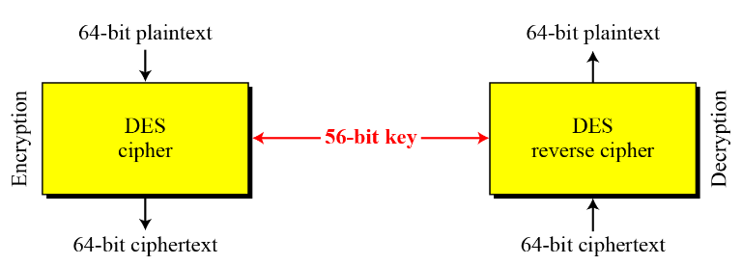

Slide 9
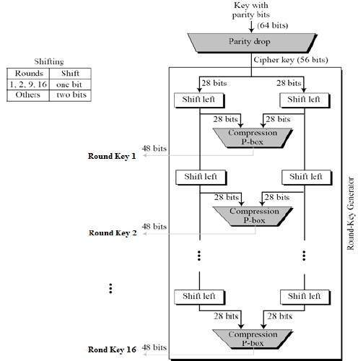

Slide 10
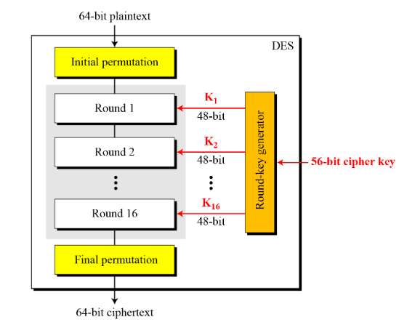
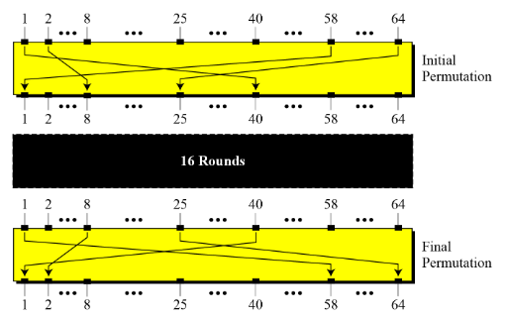
DES STRUCTURE
The encryption process is made of two permutations (P-boxes), which we call initial and final permutations, and sixteen Feistel rounds.
Initial and Final Permutations
Rounds
Cipher and Reverse Cipher
Examples
Initial and Final Permutations

Slide 11
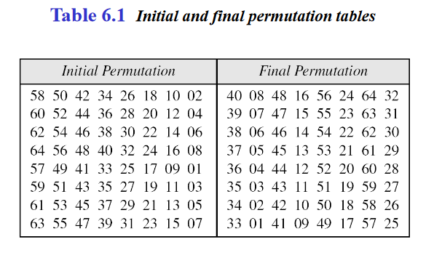
Initial and final permutation
The initial and final permutations are straight P-boxes that are inverses of each other.They have no cryptography significance in DES.

Slide 12
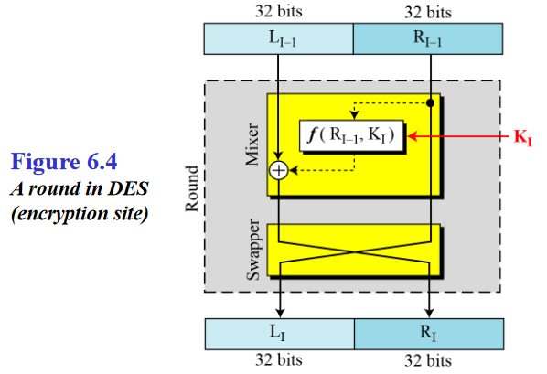
Rounds
DES uses 16 rounds. Each round of DES is a Feistel cipher.

Slide 13
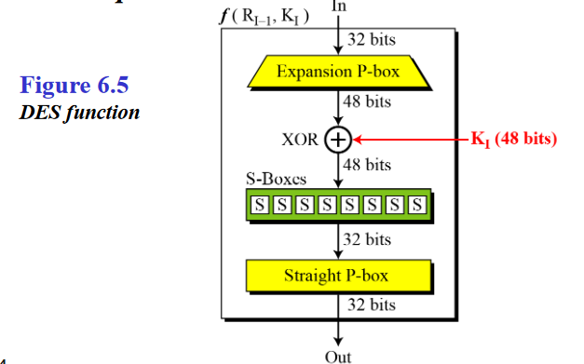
DES Function
The heart of DES is the DES function. The DES function applies a 48-bit key to the right most 32bits to produce a 32-bit output.

Slide 14
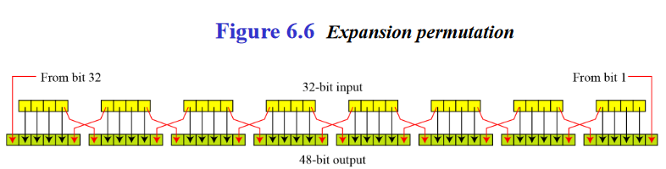
Expansion P-box
Since RI−1 is a 32-bit input and KI is a 48-bit key, we first need to expand RI−1 to 48bits
Although the relationship between the input and output can be defined mathematically, DES uses to define this P-box

Slide 15
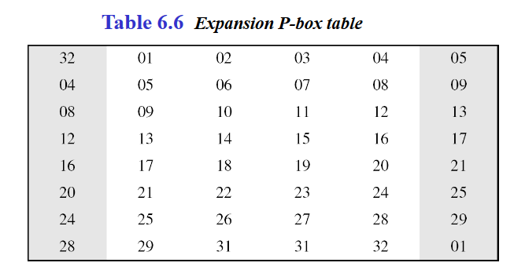
Whitener (XOR)
After the expansion permutation, DES uses the XOR operation on the expanded right section and the round key. Note that both the right section and the key are 48-bits in length. Also note that the round key is used only in this operation.

Slide 16
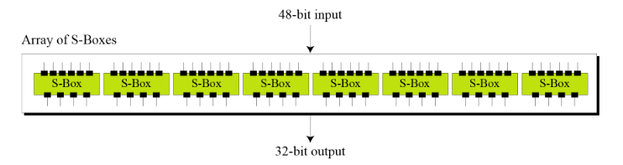
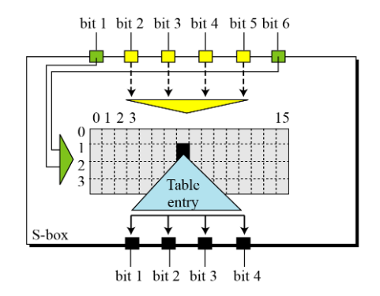
S-Boxes
The S-boxes do the real mixing (confusion). DES uses 8 S-boxes, each with a 6-bit input and a 4-bit output.

Slide 17
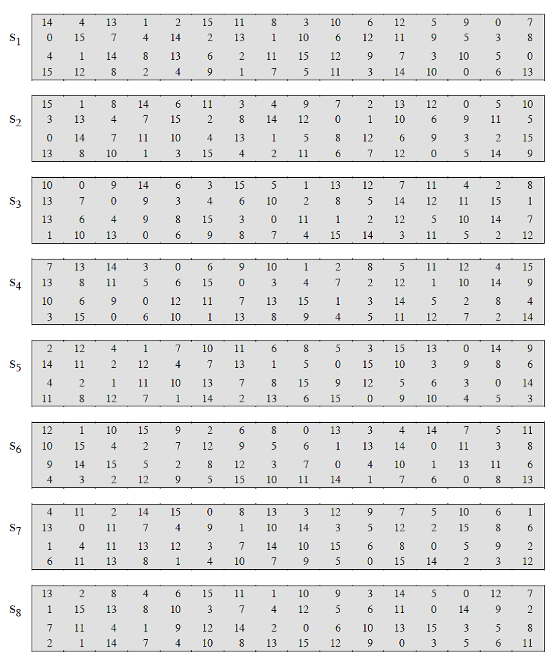

Slide 18
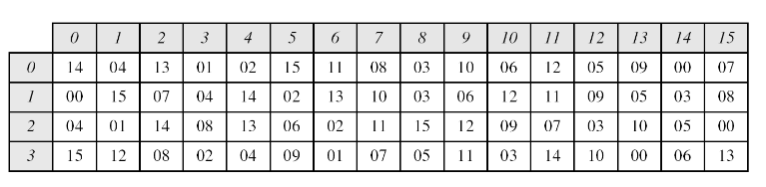
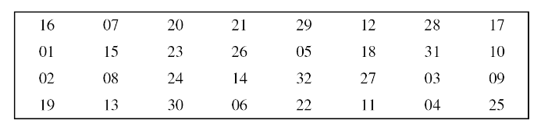
Straight Permutation

Slide 19
Cipher and Reverse Cipher
Using mixers and swappers, we can create the cipher and reverse cipher, each having 16 rounds
Cipher First Approach To achieve this goal, one approach is to make the last round(round16) different from the others; it has only a mixer and no swapper.

Slide 20
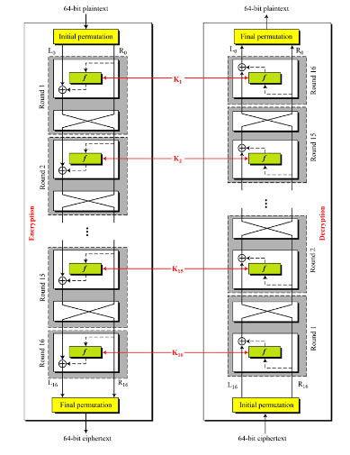

Slide 21
DES ANALYSIS
Critics have used a strong magnifier to analyse DES. Test s have been done to measure the strength of some desired properties in a block cipher.
Properties
Design Criteria
DES Weaknesses
Properties
Two desired properties of a block cipher are the avalanche effect and the completeness.
Completeness effect
Completeness effect means that each bit of the cipher text needs to depend on many bits on the plaintext.

Slide 22
Design Criteria
S-Boxes
The design provides confusion and diffusion of bits from each round to the next.
P-Boxes
They provide diffusion of bits.
Number of Rounds
DES uses sixteen rounds of Feistel ciphers. The cipher text is thoroughly a random function of plain text and cipher text.

Slide 23
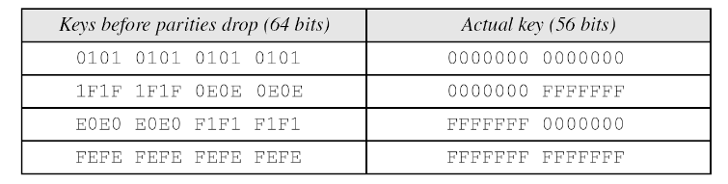
DES Weaknesses
During the last few years critics have found some weaknesses in DES
Weaknesses in Cipher Design
1. Weaknesses in S-boxes
2. Weaknesses in P-boxes
3. Weaknesses in Key

Slide 24
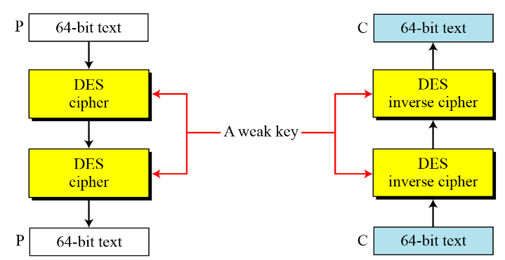
Double encryption and decryption with a weak key

Slide 25
Advanced Encryption Standard (AES)

Slide 26
The Advanced Encryption Standard (AES) is a symmetric-key block cipher published by the National Institute of Standards and Technology (NIST) in December 2001.
History
Criteria
Rounds
Data Units
Structure of Each Round

Slide 27
History.
In February 2001, NIST announced that a draft of the Federal Information Processing Standard (FIPS) was available for public review and comment. Finally, AES was published as FIPS 197 in the Federal Register in December 2001.

Slide 28
Criteria
The criteria defined by NIST for selecting AES fall into three areas:
Security
Cost
Implementation.

Slide 29

Rounds
AES is a non-Feistel cipher that encrypts and decrypts a data block of 128 bits. It uses 10, 12, or 14 rounds. The key size, which can be 128, 192, or 256 bits, depends on the number of rounds.
Note
AES has defined three versions, with 10, 12, and 14 rounds.
Each version uses a different cipher key size (128, 192, or 256), but the round keys are
always 128 bits.

Slide 30
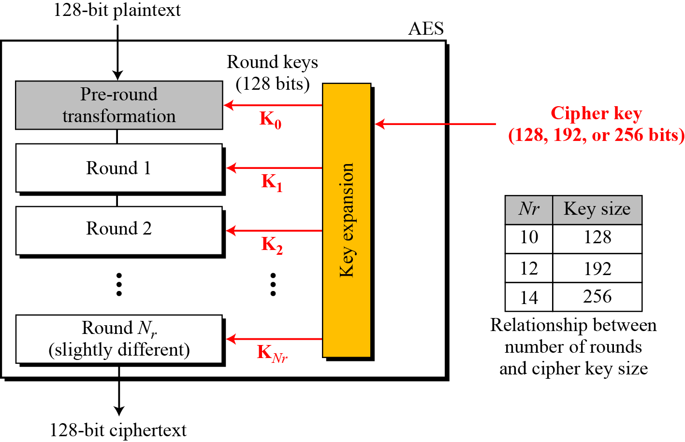
General design of AES encryption cipher

Slide 31
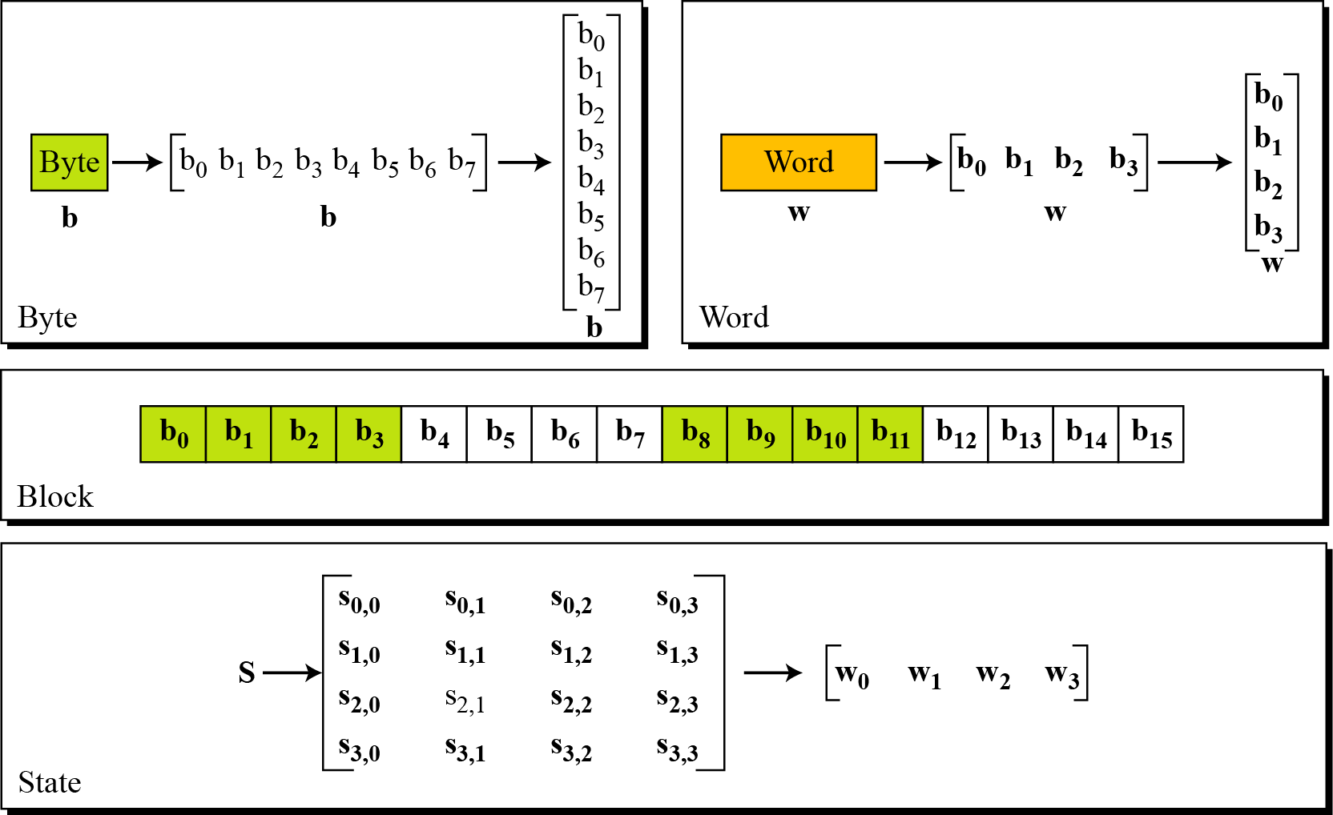
Data Units.
Data units used in AES

Slide 32
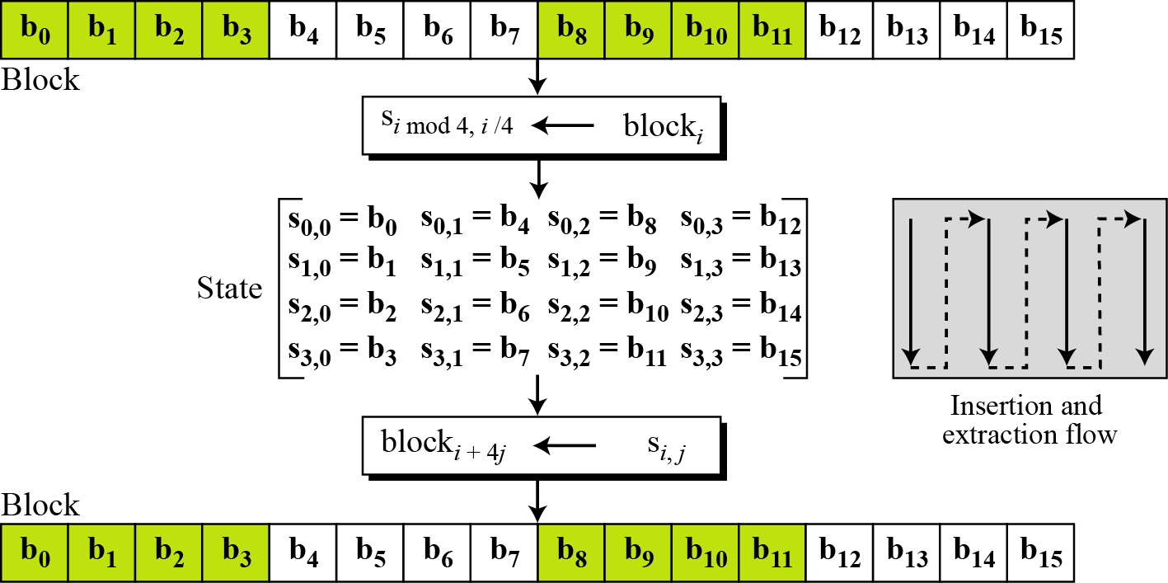
Block-to-state and state-to-block transformation

Slide 33
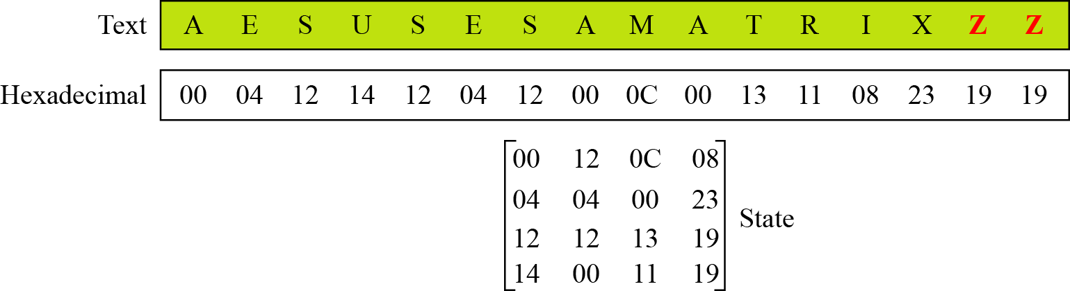
Changing plaintext to state

Slide 34
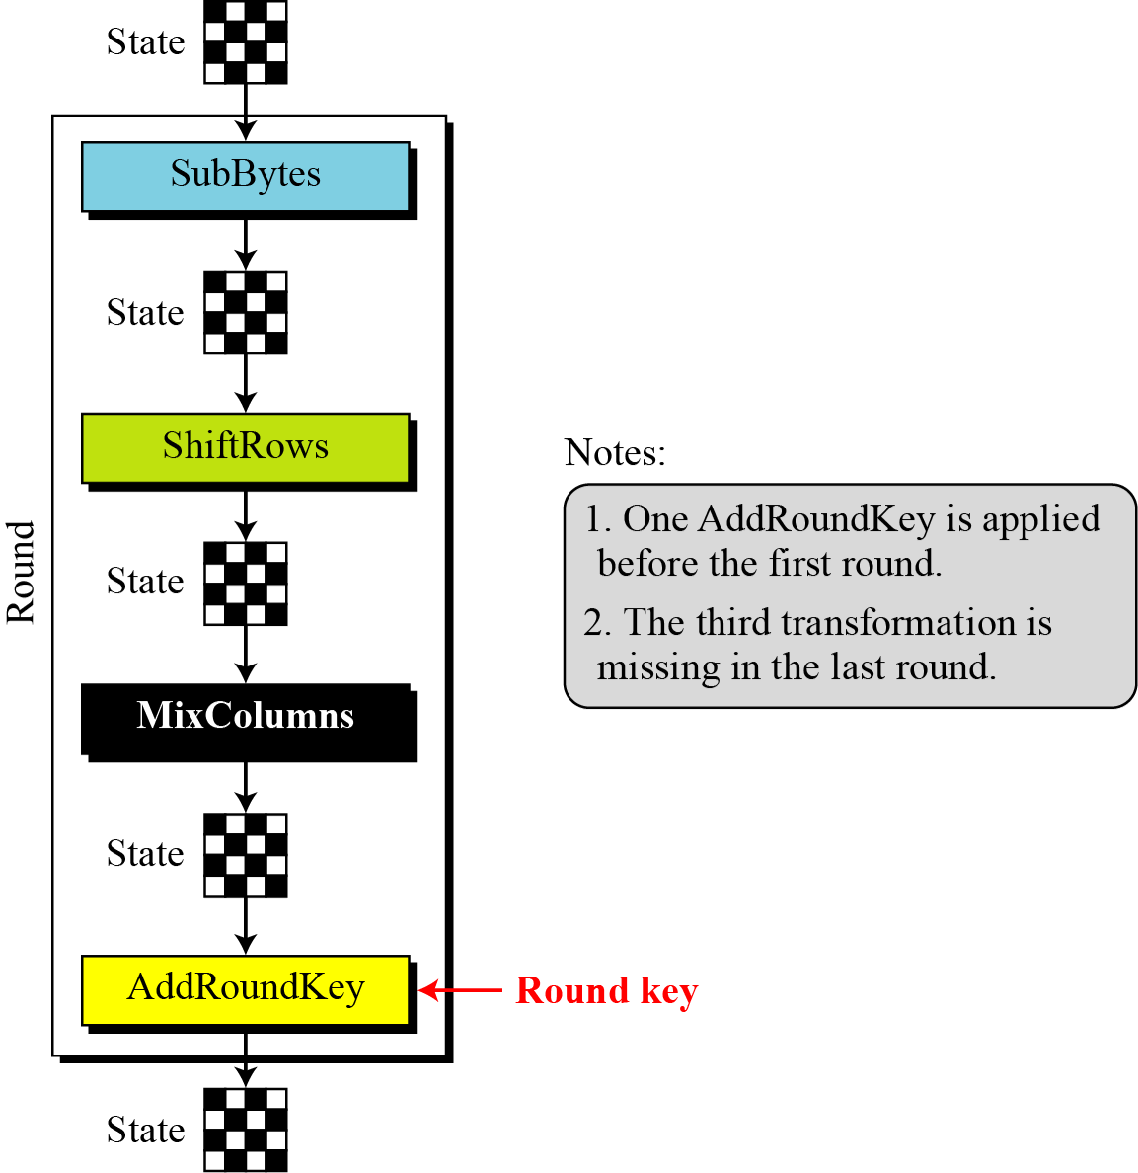
Structure of Each Round
Structure of each round at the encryption site

Slide 35
TRANSFORMATIONS
To provide security, AES uses four types of transformations: substitution, permutation, mixing, and key-adding.
Topics
Substitution
Permutation
Mixing
Key Adding

Slide 36
Substitution
AES, like DES, uses substitution. AES uses two invertible transformations.
SubBytes
The first transformation, SubBytes, is used at the encryption site. To substitute a byte, we interpret the byte as two hexadecimal digits.
Note
The SubBytes operation involves 16 independent byte-to-byte transformations.

Slide 37
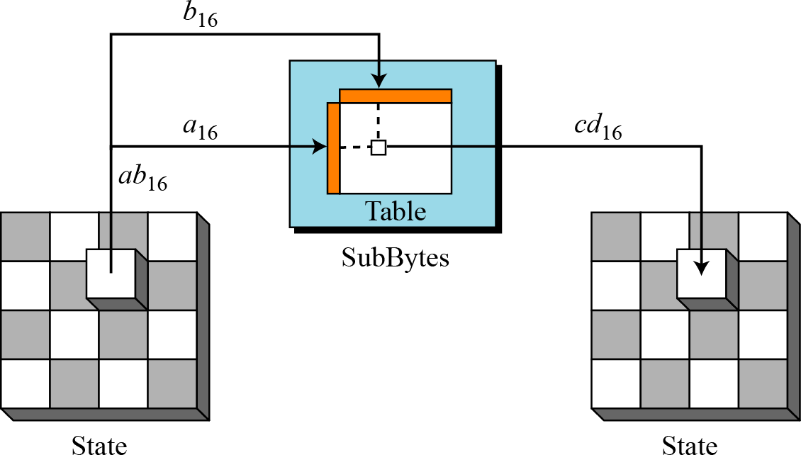
Sub Bytes transformation

Slide 38
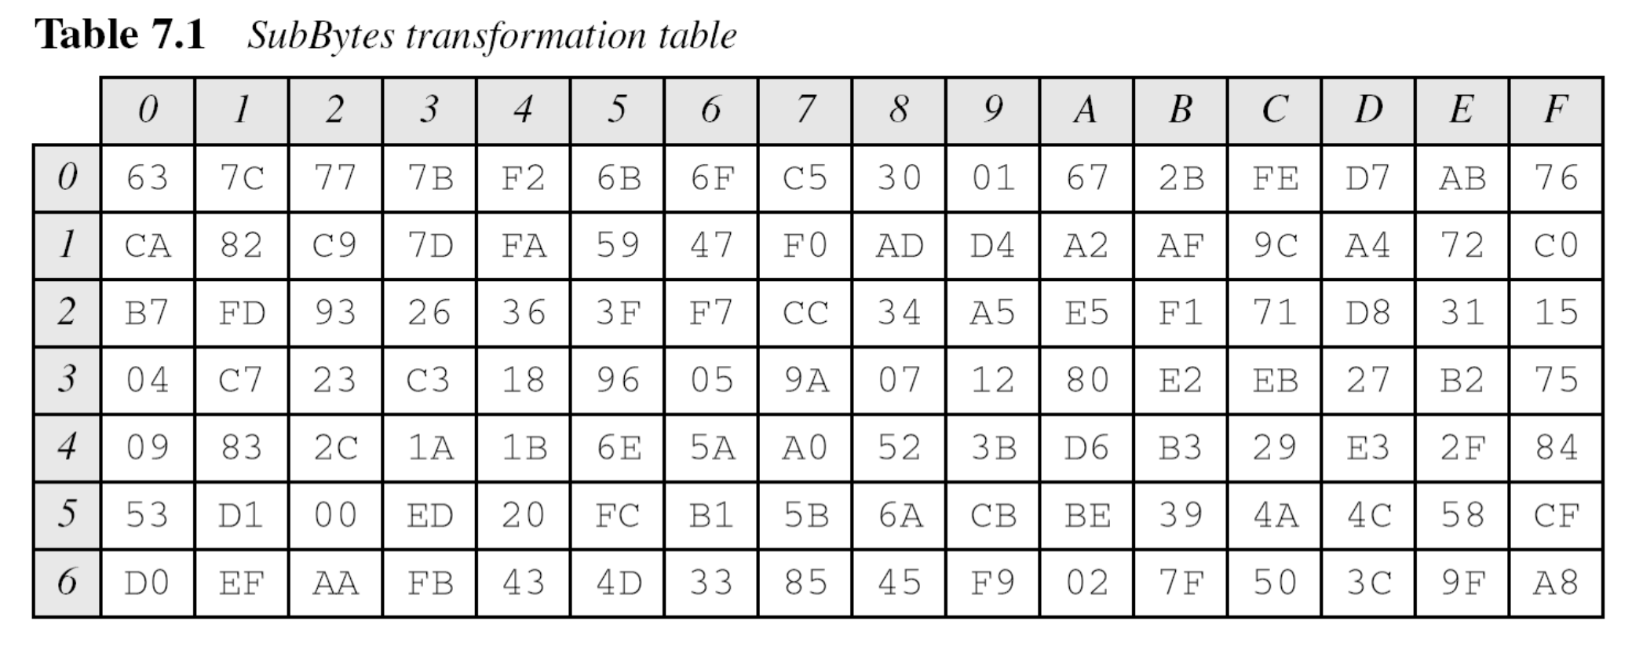

Slide 39
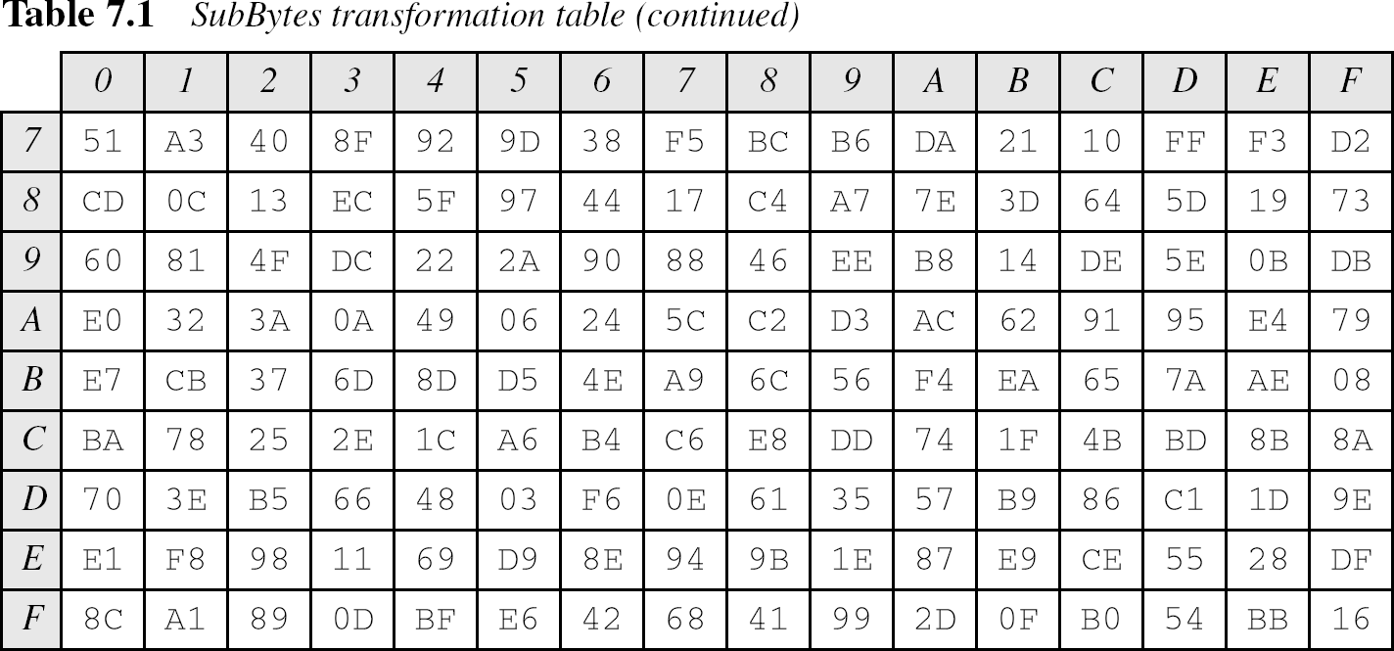

Slide 40
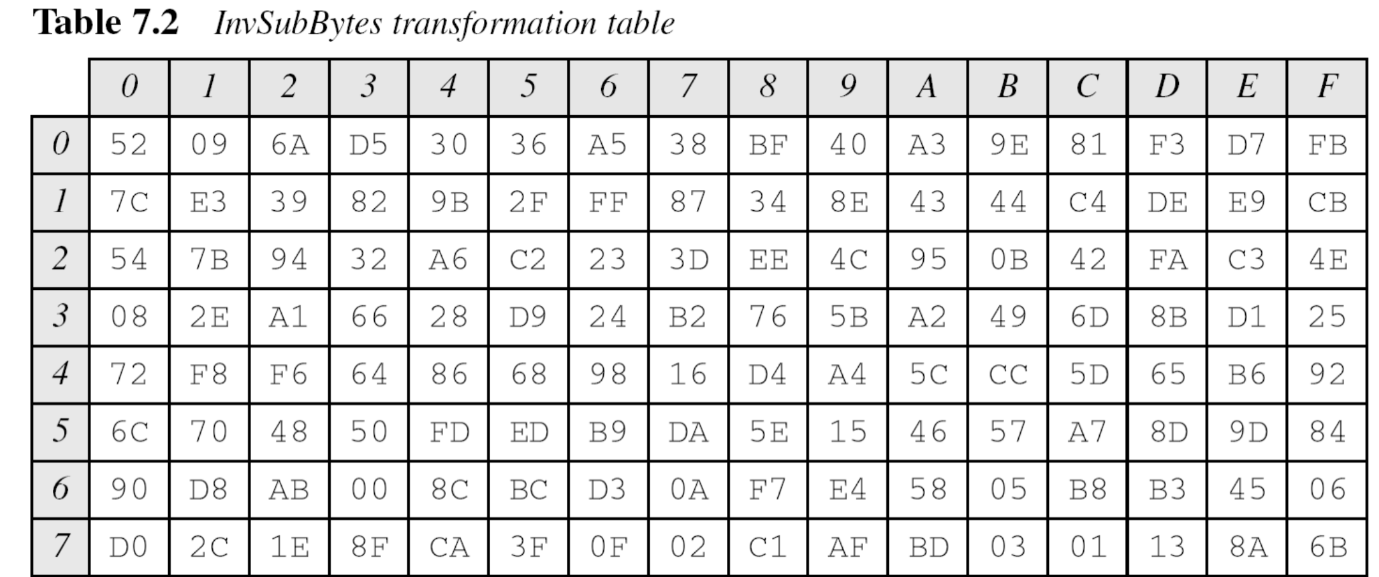
InvSubBytes

Slide 41
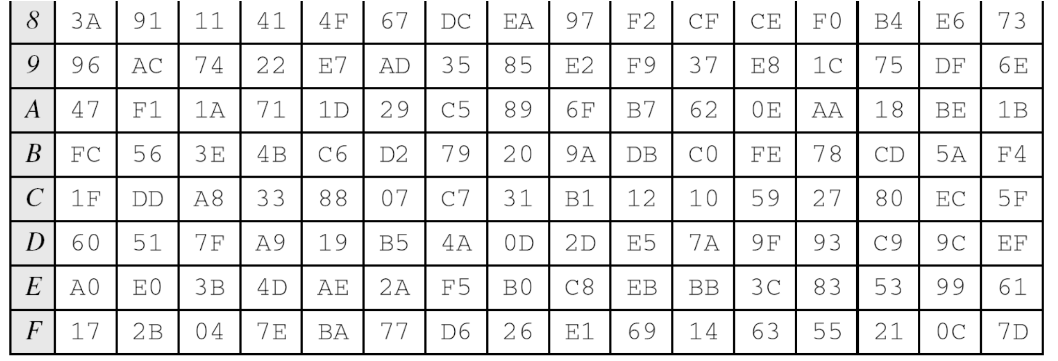
InvSubBytes

Slide 42
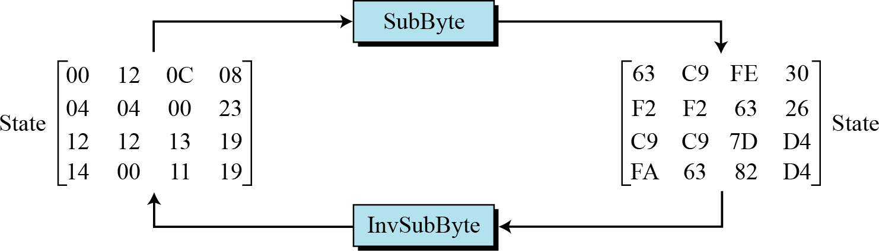
Figure 7.7 shows how a state is transformed using the SubBytes transformation. The figure also shows that the InvSubBytes transformation creates the original one. Note that if the two bytes have the same values, their transformation is also the same.
Figure 7.7 SubBytes transformation for Example 7.2

Slide 43
Transformation Using the GF(2⁸) Field
AES also defines the transformation algebraically using the GF(28) field with the irreducible polynomials (x⁸ + x⁴ + x³+ x + 1), as shown in Figure 7.8.
Note
The SubBytes and InvSubBytes transformations are inverses of each other.

Slide 44
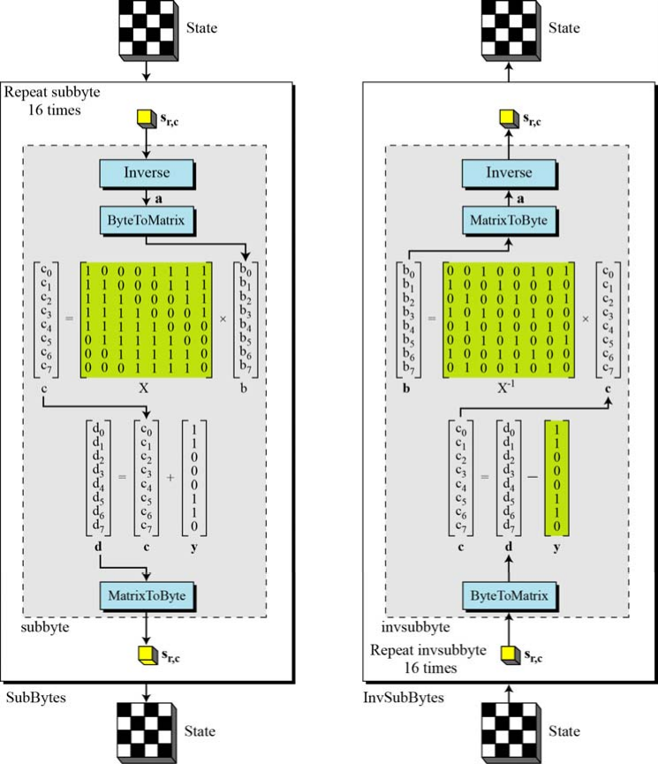
SubBytes and InvSubBytes processes

Slide 45
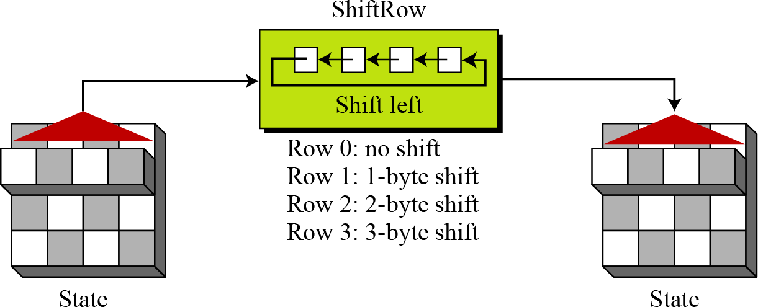
Permutation
Another transformation found in a round is shifting, which permutes the bytes.
ShiftRows
In the encryption, the transformation is called ShiftRows.
ShiftRows transformation
InvShiftRows: In the decryption, the transformation is called InvShiftRows and the shifting is to the right.

Slide 46
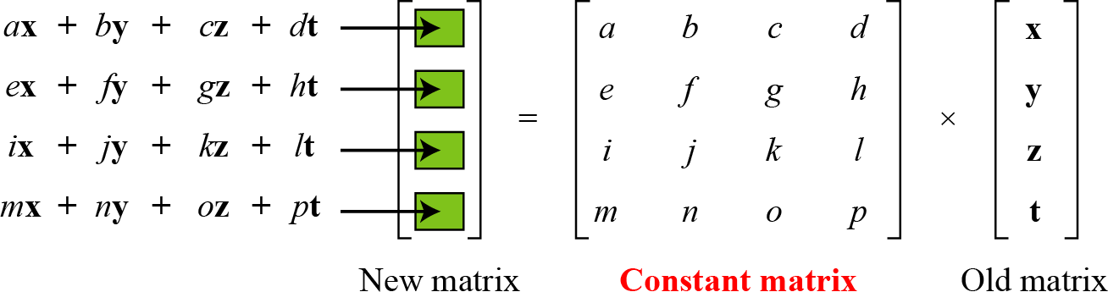
Mixing
We need an interbyte transformation that changes the bits inside a byte, based on the bits inside the neighboring bytes. We need to mix bytes to provide diffusion at the bit level.
Figure 7.11 Mixing bytes using matrix multiplication

Slide 47
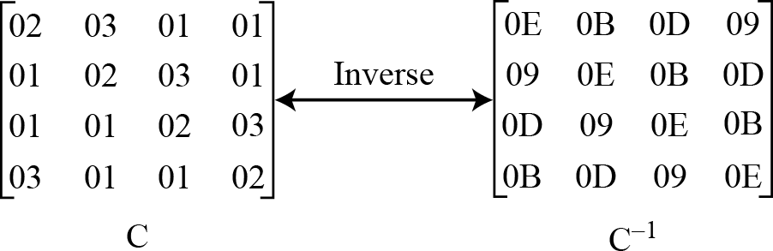
Constant matrices used by MixColumns and InvMixColumns

Slide 48
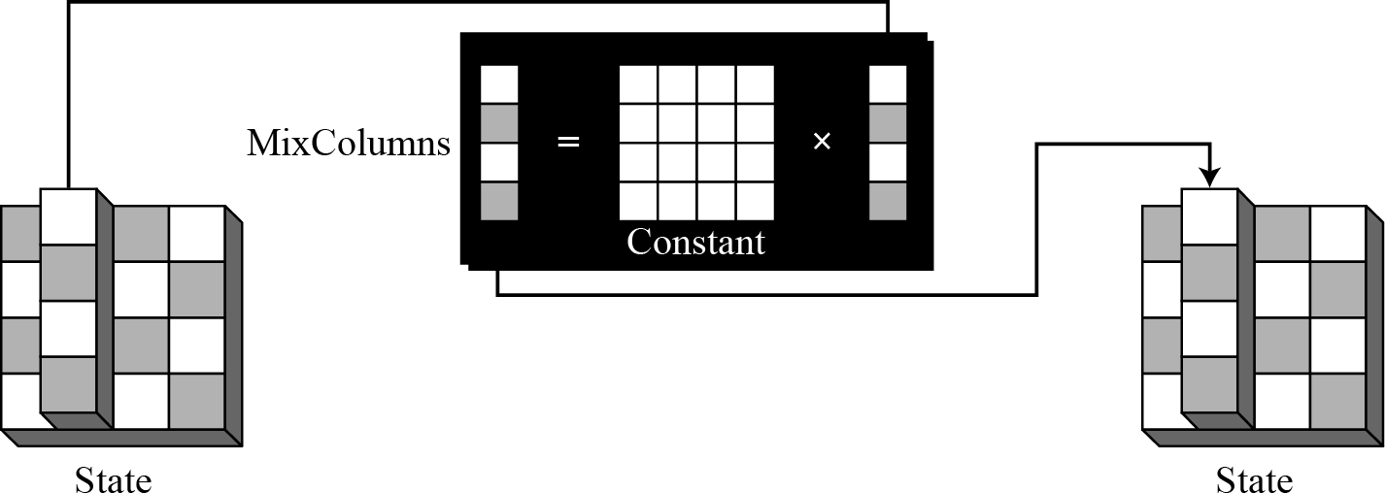
MixColumns
The MixColumns transformation operates at the column level; it transforms each column of the state to a new column.
Figure 7.13 MixColumns transformation

Slide 49
InvMixColumns
The InvMixColumns transformation is basically the same as the MixColumns transformation.
Note
The MixColumns and InvMixColumns transformations are inverses of each other.

Slide 50
Key Adding
AddRoundKey
AddRoundKey proceeds one column at a time. AddRoundKey adds a round key word with each state column matrix; the operation in AddRoundKey is matrix addition.
Note
The AddRoundKey transformation is the inverse of itself.

Slide 51
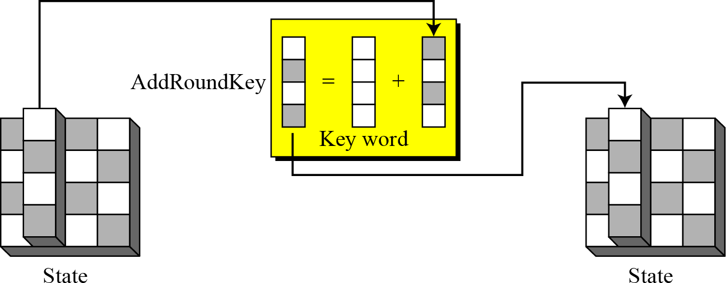
AddRoundKey transformation

Slide 52
KEY EXPANSION
To create round keys for each round, AES uses a key- expansion process. If the number of rounds is N_{r} , the key-expansion routine creates N_{r} + 1 128-bit round keys from one single 128-bit cipher key.
Key Expansion in AES-128
Key Expansion in AES-192 and AES-256
Key-Expansion Analysis

Slide 53
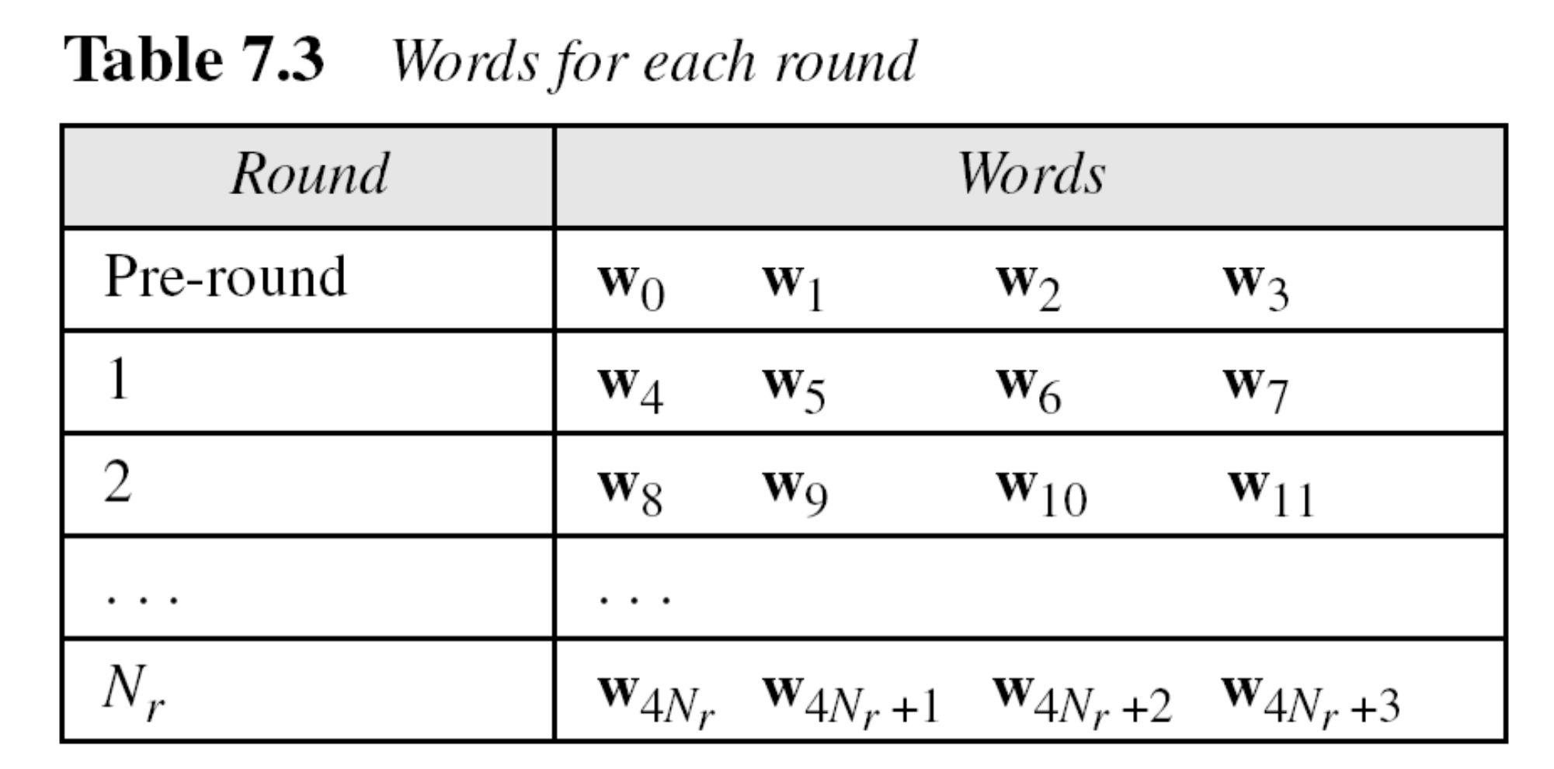

Slide 54
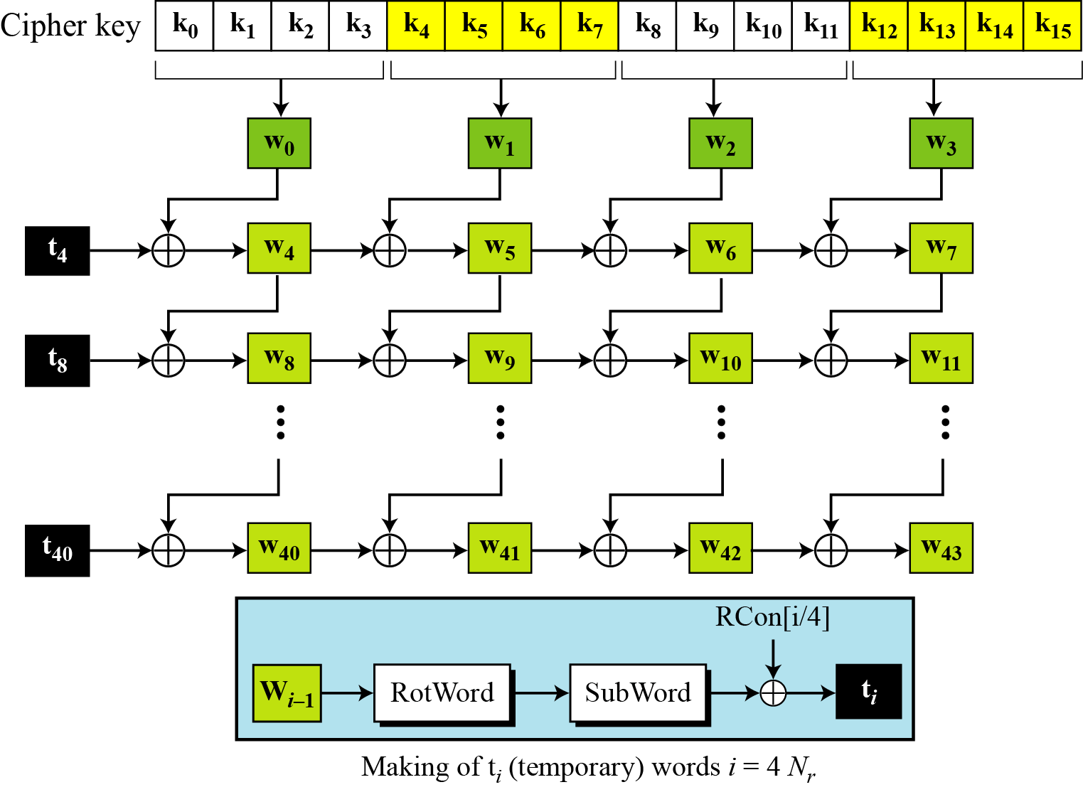
Key Expansion in AES-128
Key expansion in AES

Slide 55
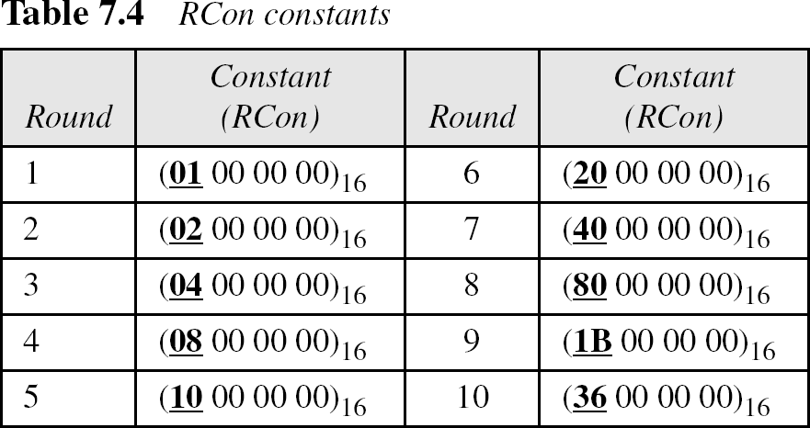

Slide 56
Asymmetric Key Encryption
Ex: Refer RSA algorithm lab program 2

Slide 57
Message Authentication
Another type of threat that exist for data is the lack of message authentication. In this threat, the user is not sure about the originator of the message. Message authentication can be provided using the cryptographic techniques that use secret keys as done in case of encryption.
Message Authentication Code (MAC)
MAC algorithm is a symmetric key cryptographic technique to provide message authentication. For establishing MAC process, the sender and receiver share a symmetric key K.
Essentially, a MAC is an encrypted checksum generated on the underlying message that is sent along with a message to ensure message authentication.

Slide 58
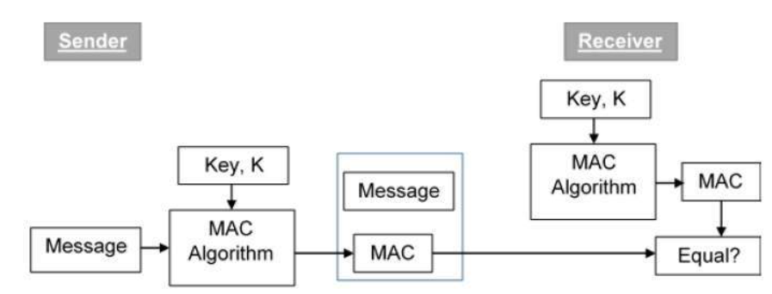

Slide 59
Let us now try to understand the entire process in detail −
The sender uses some publicly known MAC algorithm, inputs the message and the secret key K and produces a MAC value.
Similar to hash, MAC function also compresses an arbitrary long input into a fixed length output. The major difference between hash and MAC is that MAC uses secret key during the compression.
The sender forwards the message along with the MAC. Here, we assume that the message is sent in the clear, as we are concerned of providing message origin authentication, not confidentiality. If confidentiality is required then the message needs encryption.
On receipt of the message and the MAC, the receiver feeds the received message and the shared secret key K into the MAC algorithm and re-computes the MAC value.
The receiver now checks equality of freshly computed MAC with the MAC received from the sender. If they match, then the receiver accepts the message and assures himself that the message has been sent by the intended sender.
If the computed MAC does not match the MAC sent by the sender, the receiver cannot determine whether it is the message that has been altered or it is the origin that has been falsified. As a bottom-line, a receiver safely assumes that the message is not the genuine.

Slide 60
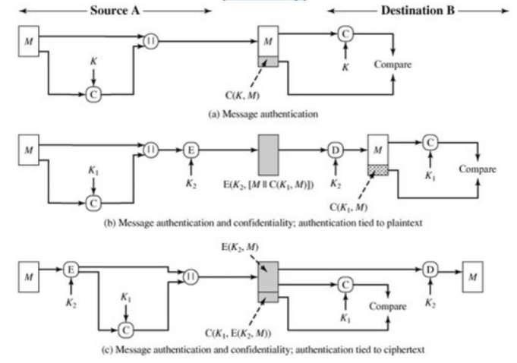

Slide 61
Digital Signatures
Digital signatures are the public-key primitives of message authentication. In the physical world, it is common to use handwritten signatures on handwritten or typed messages. They are used to bind signatory to the message.
Similarly, a digital signature is a technique that binds a person/entity to the digital data. This binding can be independently verified by receiver as well as any third party.
Digital signature is a cryptographic value that is calculated from the data and a secret key known only by the signer.
Model of Digital Signature
The digital signature scheme is based on public key cryptography. The model of digital signature scheme is depicted in the following illustration −

Slide 62
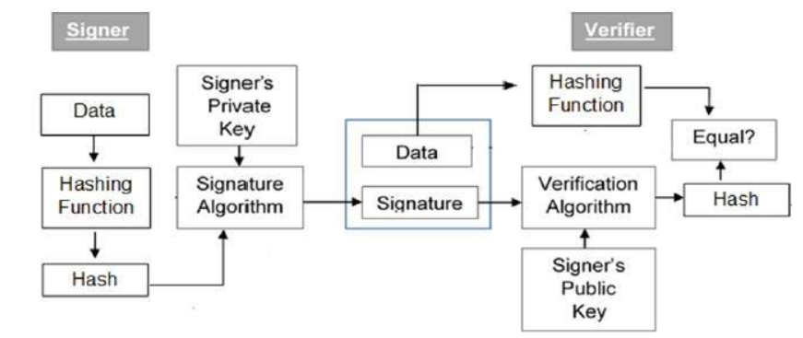

Slide 63
The following points explain the entire process in detail −
Each person adopting this scheme has a public-private key pair.
Generally, the key pairs used for encryption/decryption and signing/verifying are different. The private key used for signing is referred to as the signature key and the public key as the verification key.
Signer feeds data to the hash function and generates hash of data.
Hash value and signature key are then fed to the signature algorithm which produces the digital signature on given hash. Signature is appended to the data and then both are sent to the verifier.
Verifier feeds the digital signature and the verification key into the verification algorithm. The verification algorithm gives some value as output.
Verifier also runs same hash function on received data to generate hash value.
For verification, this hash value and output of verification algorithm are compared. Based on the comparison result, verifier decides whether the digital signature is valid.
Since digital signature is created by ‘private’ key of signer and no one else can have this key; the signer cannot repudiate signing the data in future.

Slide 64
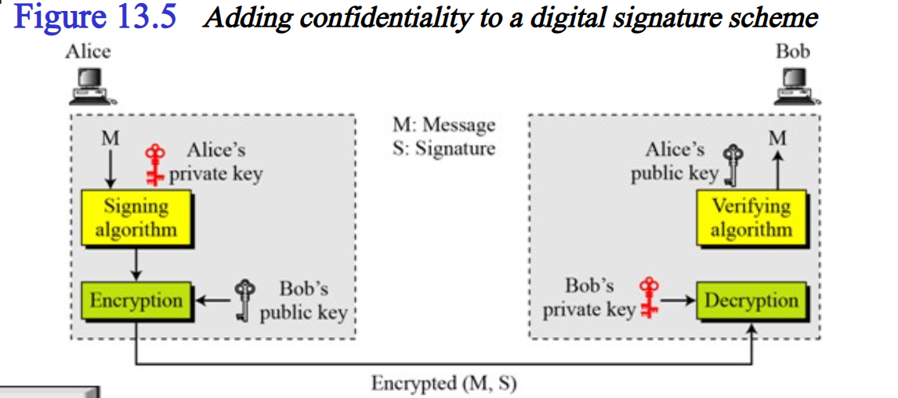

Slide 65
Importance of Digital Signature
Out of all cryptographic primitives, the digital signature using public key cryptography is considered as very important and useful tool to achieve information security.
Apart from ability to provide non-repudiation of message, the digital signature also provides message authentication and data integrity. Let us briefly see how this is achieved by the digital signature −
Message authentication − When the verifier validates the digital signature using public key of a sender, he is assured that signature has been created only by sender who possess the corresponding secret private key and no one else.
Data Integrity − In case an attacker has access to the data and modifies it, the digital signature verification at receiver end fails. The hash of modified data and the output provided by the verification algorithm will not match. Hence, receiver can safely deny the message assuming that data integrity has been breached.
Non-repudiation − Since it is assumed that only the signer has the knowledge of the signature key, he can only create unique signature on a given data. Thus the receiver can present data and the digital signature to a third party as evidence if any dispute arises in the future.

Slide 66
Applications of Cryptography
There are various applications of cryptography which are as follows −
Secrecy in Transmission − Some existing secrecy systems for transmission access a private key system for converting transmitted data because it is the quickest approach that functions with rational guarantee and low overhead.
If the multiple conversing parties is minute, key distribution is implemented periodically with a courier service and key preservation based on physical security of the keys over the method of use and destruction after new keys are disseminated.
Secrecy in Storage − Secrecy in storage is frequently preserved by a one-key system where the user provide the key to the computer at the commencement of a session, and the system creates concern of encryption and decryption during the phase of normal use.
Integrity in Transmission − Some users of communication systems are not as much worried concerning secrecy as about integrity. In a computer funds transfer, the sum sent from one account to another is usually public knowledge.
If an operating tapper can bring in a false transfer, funds can be shared illegally. An inaccuracy in an individual bit can cause millions of dollars to be wrongly credited or debited. Cryptographic methods are generally used to provide that intentional or accidental modification of transmitted data does not cause flawed actions to appear.
Integrity in Storage − The central meaning of assuring integrity of accumulated data has previously been access control. Access control contains systems of locks and keys, guards, and other approaches of a physical or logical feature.
The recent advent of computer viruses has altered this to an important degree, and the use of cryptographic checksums for assuring the integrity of stored data is becoming broad.

Slide 67
Authentication of Identity − Authenticating the identity of individuals or systems to each other has been a difficulty for a very long time. Simple passwords have been used to test identity. More compound protocols such as sequence of keywords exchanged between sets of parties are generally display in the movies or on television.
Credentialing Systems − A credential is generally a file that introduces one party to another by referencing a usually known trusted party. When credit is used for, references are usually requested. The credit of the references is determined and they are contacted to discover out the tested of the applicant. Credit cards are generally used to credential an individual to achieve more credit cards.
Electronic Signatures − Electronic signatures are a means of monetary a lawfully binding transaction among two or more parties. It can be as functional as a physical signature, electronic signatures should be at least as hard to fake at least as simple to use, and accepted in a court of law as binding upon some parties to the operation.

Slide 68
Overview of Firewalls
A firewall is a network security device, either hardware or software-based, which monitors all incoming and outgoing traffic and based on a defined set of security rules it accepts, rejects or drops that specific traffic.
Accept : allow the traffic Reject : block the traffic but reply with an “unreachable error” Drop : block the traffic with no reply
A firewall establishes a barrier between secured internal networks and outside untrusted network, such as the Internet.

Slide 69
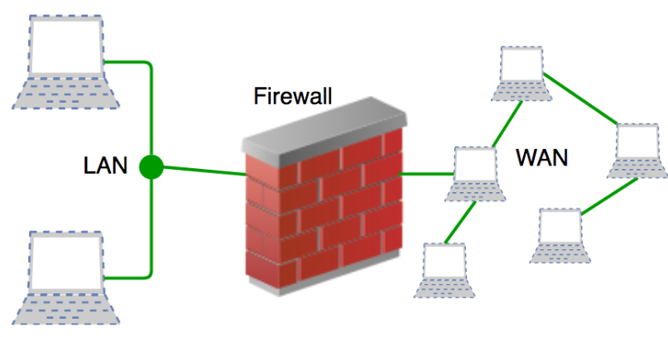

Slide 70
Firewall History
Firewalls have existed since the late 1980’s and started out as packet filters, which were networks set up to examine packets, or bytes, transferred between computers. Though packet filtering firewalls are still in use today, firewalls have come a long way as technology has developed throughout the decades.
Gen 1 Virus
Generation 1, Late 1980’s, virus attacks on stand-alone PC’s affected all businesses and drove anti-virus products.
Gen 2 Networks
Generation 2, Mid 1990’s, attacks from the internet affected all business and drove creation of the firewall.
Gen 3 Applications
Generation 3, Early 2000’s, exploiting vulnerabilities in applications which affected most businesses and drove Intrusion Prevention Systems Products (IPS).
Gen 4 Payload
Generation 4, Approx. 2010, rise of targeted, unknown, evasive, polymorphic attacks which affected most businesses and drove anti-bot and sandboxing products.
Gen 5 Mega
Generation 5, Approx. 2017, large scale, multi-vector, mega attacks using advance attack tools and is driving advance threat prevention solutions.
What Firewalls Do?
Firewalls, and especially Next Generation Firewalls, focus on blocking malware and application-layer attacks, along with an integrated intrusion prevention system (IPS), these Next Generation Firewalls can react quickly and seamlessly to detect and react to outside attacks across the whole network.

Slide 71
Types of Firewall
There are mainly three types of firewalls, such as software firewalls, hardware firewalls, or both, depending on their structure.
Each type of firewall has different functionality but the same purpose. However, it is best practice to have both to achieve maximum possible protection.
A hardware firewall is a physical device that attaches between a computer network and a gateway.
For example- a broadband router.
A hardware firewall is sometimes referred to as an Appliance Firewall.
On the other hand, a software firewall is a simple program installed on a computer that works through port numbers and other installed software. This type of firewall is also called a Host Firewall.

Slide 72
1. Packet Filtering Firewalls
Packet filtering firewalls are the oldest, most basic type of firewalls.
Operating at the network layer, they check a data packet for its source IP and destination IP, the protocol, source port, and destination port against predefined rules to determine whether to pass or discard the packet.
Packet filtering firewalls are essentially stateless, monitoring each packet independently without any track of the established connection or the packets that have passed through that connection previously.
This makes these firewalls very limited in their capacity to protect against advanced threats and attacks.
Packet filtering firewalls are fast, cheap, and effective.
But the security they provide is very basic.
Since these firewalls cannot examine the content of the data packets, they are incapable of protecting against malicious data packets coming from trusted source IPs.
Being stateless, they are also vulnerable to source routing attacks and tiny fragment attacks.
But despite their minimal functionality, packet filtering firewalls paved the way for modern firewalls that offer stronger and deeper security.

Slide 73
2. Circuit-Level Gateways
Working at the session layer, circuit-level gateways verify established Transmission Control Protocol (TCP) connections and keep track of the active sessions.
They are quite similar to packet filtering firewalls in that they perform a single check and utilize minimal resources.
However, they function at a higher layer of the Open Systems Interconnection (OSI) model.
Primarily, they determine the security of an established connection.
When an internal device initiates a connection with a remote host, circuit-level gateways establish a virtual connection on behalf of the internal device to keep the identity and IP address of the internal user hidden.
Circuit-level gateways are cost-efficient, simplistic, barely impact a network’s performance.
However, their inability to inspect the content of data packets makes them an incomplete security solution on their own.
A data packet containing malware can bypass a circuit-level gateway easily if it has a legitimate TCP handshake.
That is why another type of firewall is often configured on top of circuit-level gateways for added protection.

Slide 74
3. Stateful Inspection Firewalls
A step ahead of circuit-level gateways, stateful inspection firewalls, and verifying and keeping track of established connections also perform packet inspection to provide better, more comprehensive security.
They work by creating a state table with source IP, destination IP, source port, and destination port once a connection is established.
They create their own rules dynamically to allow expected incoming network traffic instead of relying on a hardcoded set of rules based on this information.
They conveniently drop data packets that do not belong to a verified active connection.
Stateful inspection firewalls check for legitimate connections and source and destination IPs to determine which data packets can pass through.
Although these extra checks provide advanced security, they consume a lot of system resources and can slow down traffic considerably.
Hence, they are prone to DDoS (distributed denial-of-service attacks).

Slide 75
4. Application-Level Gateways (Proxy Firewalls)
Application-level gateways, also known as proxy firewalls, are implemented at the application layer via a proxy device.
Instead of an outsider accessing your internal network directly, the connection is established through the proxy firewall.
The external client sends a request to the proxy firewall.
After verifying the authenticity of the request, the proxy firewall forwards it to one of the internal devices or servers on the client’s behalf.
Alternatively, an internal device may request access to a webpage, and the proxy device will forward the request while hiding the identity and location of the internal devices and network.
Unlike packet filtering firewalls, proxy firewalls perform stateful and deep packet inspection to analyze the context and content of data packets against a set of user-defined rules.
Based on the outcome, they either permit or discard a packet.
They protect the identity and location of your sensitive resources by preventing a direct connection between internal systems and external networks.
However, configuring them to achieve optimal network protection can be tricky.
You must also keep in mind the tradeoff—a proxy firewall is essentially an extra barrier between the host and the client, causing considerable slowdowns.

Slide 76
User Management
User management is an organizational function that enables users to access and control digital assets, such as applications, devices, networks, and cloud services.
Organizations are now exploring even more advanced solutions. Modern user management services provide end-to-end management of user accounts, including user registration, login and authentication, single sign-on (SSO), and permissions management.
User management functions include:
Preventing unauthorized access to infrastructure, applications, and data
Storing user details and credentials
Providing a convenient login mechanism for end-users
Allowing users to set and reset passwords
Enabling multi-factor authentication (MFA)
Assigning user rights to systems, services, and applications
Managing user entitlements within services and applications

Slide 77
A solution commonly used to implement user management is identity and access management (IAM).
IAM enables administrators to define access to IT resources, both for internal and external users.
IAM either includes or integrates with a user directory service, which contains credentials and other details of all users.
The directory service enforces access controls by authenticating, authorizing, and auditing user access.
The Need for Modern User Management
User management allows administrators to manage resources and organize users according to their needs and roles while maintaining the security of IT systems.
Administrators need powerful user management capabilities that can allow them to group users and define flexible access policies.
For end-users, many parts of user management are invisible.
When users are exposed to user management—for example, when they use a login box to access an application—they expect the interaction to be simple and seamless.
Login is a frequently-performed, critical operation, meaning that any delay or malfunction annoys users and hurts productivity.

Slide 78
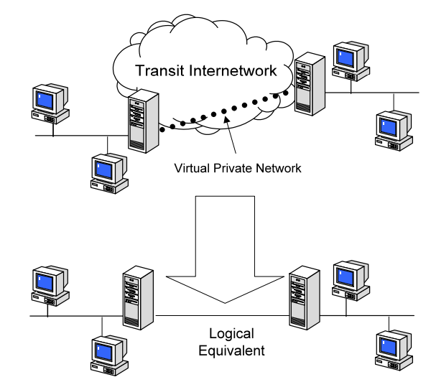
VPN Security
VPN stands for "Virtual Private Network" and describes the opportunity to establish a protected network connection when using public networks. VPNs encrypt your internet traffic and disguise your online identity. This makes it more difficult for third parties to track your activities online and steal data. The encryption takes place in real time.

Slide 79
Why should you use a VPN connection?
Your ISP usually sets up your connection when you connect to the internet.
It tracks you via an IP address.
Your network traffic is routed through your ISP's servers, which can log and display everything you do online.
Your ISP may seem trustworthy, but it may share your browsing history with advertisers, the police or government, and/or other third parties.
ISPs can also fall victim to attacks by cyber criminals: If they are hacked, your personal and private data can be compromised.
This is especially important if you regularly connect to public Wi-Fi networks.
You never know who might be monitoring your internet traffic and what they might steal from you, including passwords, personal data, payment information, or even your entire identity.

Slide 80
What are the benefits of a VPN connection?
A VPN connection disguises your data traffic online and protects it from external access. Unencrypted data can be viewed by anyone who has network access and wants to see it. With a VPN, hackers and cyber criminals can’t decipher this data.
Secure encryption: To read the data, you need an encryption key . Without one, it would take millions of years for a computer to decipher the code in the event of a brute force attack . With the help of a VPN, your online activities are hidden even on public networks.
Disguising your whereabouts : VPN servers essentially act as your proxies on the internet. Because the demographic location data comes from a server in another country, your actual location cannot be determined. In addition, most VPN services do not store logs of your activities. Some providers, on the other hand, record your behavior, but do not pass this information on to third parties. This means that any potential record of your user behavior remains permanently hidden.
Access to regional content: Regional web content is not always accessible from everywhere. Services and websites often contain content that can only be accessed from certain parts of the world. Standard connections use local servers in the country to determine your location. This means that you cannot access content at home while traveling, and you cannot access international content from home. With VPN location
spoofing , you can switch to a server to another country and effectively “change” your location.
Secure data transfer: If you work remotely, you may need to access important files on your company’s network. For security reasons, this kind of information requires a secure connection. To gain access to the network, a VPN connection is often required. VPN services connect to private servers and use encryption methods to reduce the risk of data leakage.

Slide 81
Security Protocols
A protocol is a series of steps carried out by two or more entities. Ex: HTTP, TCP, SMTP
A security protocol is a protocol that runs in an untrusted environment and tries to achieve a security goal.
Academic examples Industrial examples
Needham-Schroeder-Lowe Kerberos
Diffie Hellman key exchange SSL/TLS PAKE IPSec
Security protocols usually assume:
■ Untrusted channels: Hostile agents that do not participate in the protocol have access to the communication medium.
■ Dishonest participants: Hostile agents that claim to be honest, but try to prevent the security goals from being achieved.

